Slide 1
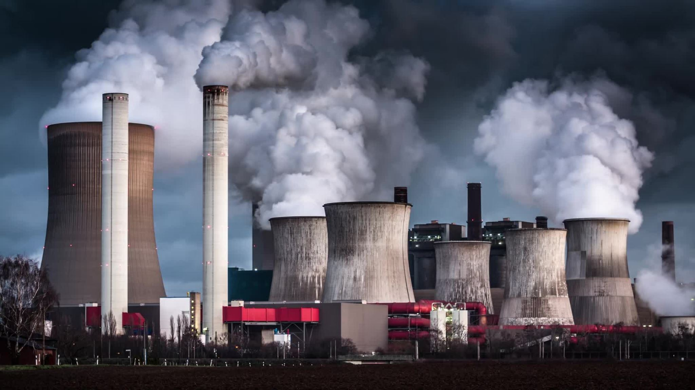
Transitioning Texas to a Renewable Energy Future: Reducing Carbon Footprint and Electricity Consumption Patterns

Slide 2

The Digital Dilemma - Electricity Trends in the 21st Century
Screen addiction is a huge deal in the modern era. An average American spends about 11 hours staring at various devices. Lives have started to become dependent on the constant supply of power.
The number of connected devices is expected to grow exponentially over the years.. The power grid needs to keep up with this growth.
We need to ask a simple question as to whether there is life beyond the plug?

Slide 3
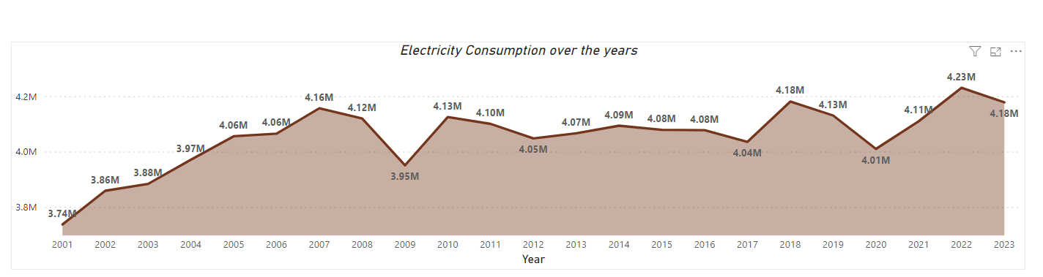
Electricity Consumption in the U.S. - A Steady Climb
U.S. electricity consumption has skyrocketed over the past decades, reaching an all-time high of 4.07 trillion kWh in 2022, a staggering 13% increase since 2001 and 14 times greater than electricity use in 1950.

Slide 4
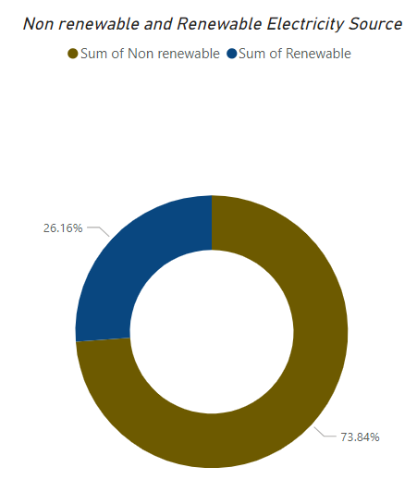
Electricity Generation in the U.S. - Renewable vs. Non-Renewable
As seen from the chart, US generates most of its electricity from non renewable sources , almost about 73.84% with only about a small chunk from renewable.
Renewable sources just contribute to about one third of the total country’s electricity consumption.

Slide 5
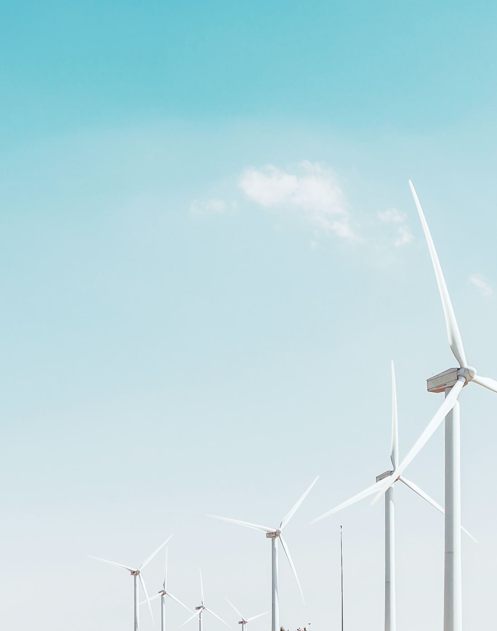
Reducing Carbon Emissions from Electricity Generation
The US electricity contributes to about 22% of the country’s CO2 emissions.
Renewable energy sources would have much lower carbon emissions compared to non-renewable sources.
Calculators are available to estimate Carbon emissions reductions by replacing fossil fuels with renewable energy.

Slide 6
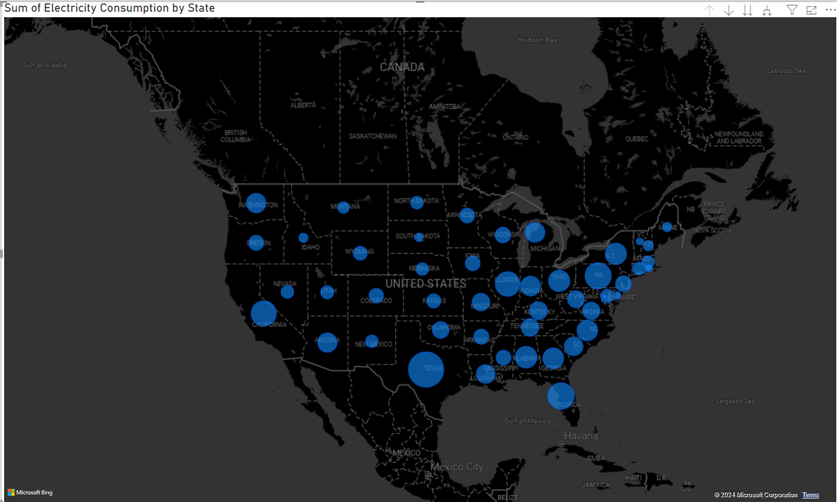
Electricity Consumption in the U.S. - Texas Leads the Pack
As seen from the map above Texas leads the nation in electricity consumption and it is about 12% of the total nation’s consumption.
In January 2024, Texas' electricity consumption reached record highs. Texas consumes almost all of the electricity that it generates only sharing a small portion to the other states.
Notes:
States with largest blue circles (indicating highest consumption) include Texas, California, Florida, New York, and Pennsylvania.
Midwest and Great Plains states generally have smaller circles, suggesting lower overall consumption.
Consumption patterns appear to correlate with population density, with more populated coastal states using more electricity.
Northeastern states as a region show relatively high electricity usage compared to other regions.
Western states like Nevada and Arizona have moderate consumption levels despite lower populations, likely due to hot climates requiring more cooling.

Slide 7
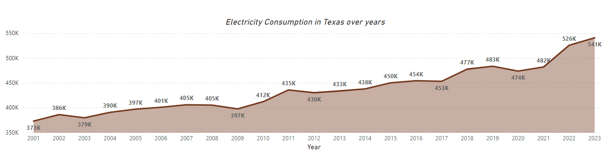
Electricity Consumption in Texas
Texas electricity demand has grown by an average of 6% year-over-year
Over the past 10 years, Texas has increased by a huge margin with respect to electricity generation.
With continued population growth and economic expansion, Texas' electricity consumption is poised for further increases in the coming years
Notes:
Texas is the nation's largest electricity consumer and producer, it is also leading the way in renewable energy generation, particularly wind power
Electricity consumption in Texas has shown a steady upward trend, increasing from 378K MWh in 2001 to 482K MWh in 2020, reflecting the state's growing population and economic activity.
There was a noticeable dip in consumption during the late 2000s, likely due to the impact of the Great Recession on economic activity.
The sharpest year-over-year increase in consumption occurred between 2017 and 2018, with an increase of around 25K MWh, possibly driven by factors such as population growth or industrial expansion.
Projections for 2023 indicate that electricity consumption in Texas will continue to rise, reaching 474K MWh, further highlighting the state's increasing energy demands.
Despite fluctuations, the overall trend demonstrates a consistent long-term growth in electricity consumption, underscoring the importance of ensuring adequate energy infrastructure and exploring diverse energy sources to meet Texas's future needs.

Slide 8
But what’s the split among the rising trend?

Slide 9
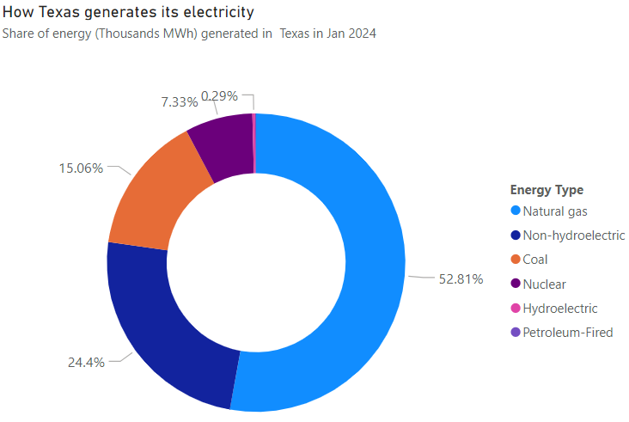
Graph showing Texas having the highest nonrenewable source of electricity generation
In 2022, Texas is a frontrunner in wind power production nationwide where it accounted for 26%.
At more than 18,000 MW, the end of 2023 will have seen almost double solar capabilities growth than last year- this is according to forecasts provided what we already know
Texas has a broad selection of power sources that include traditional power sources like oil to renewable ones such as nuclear fuel cells; this helps to meet growing demand for electricity in Texas as people move here and companies expand.

Slide 10
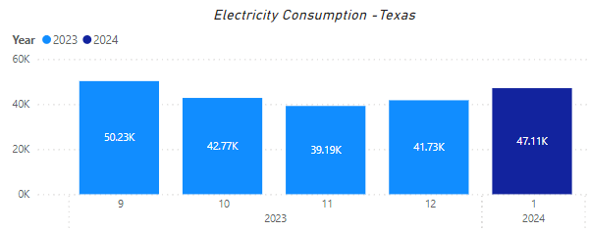
Graph showing last 5 months of electricity usuage
To understand the electricity consumption in the Texas over the recent 5 months we can refer to the bar chart on the right which suggests that electricity consumption on an average in the recent few months is more than the average of the other states in the US and Texas is a good sample set to study the demand and supply of electricity in the US and for the system to predict the demand over the next few months which would in turn make us understand the steps to be taken to optimize electricity in Texas in the future months.

Slide 11
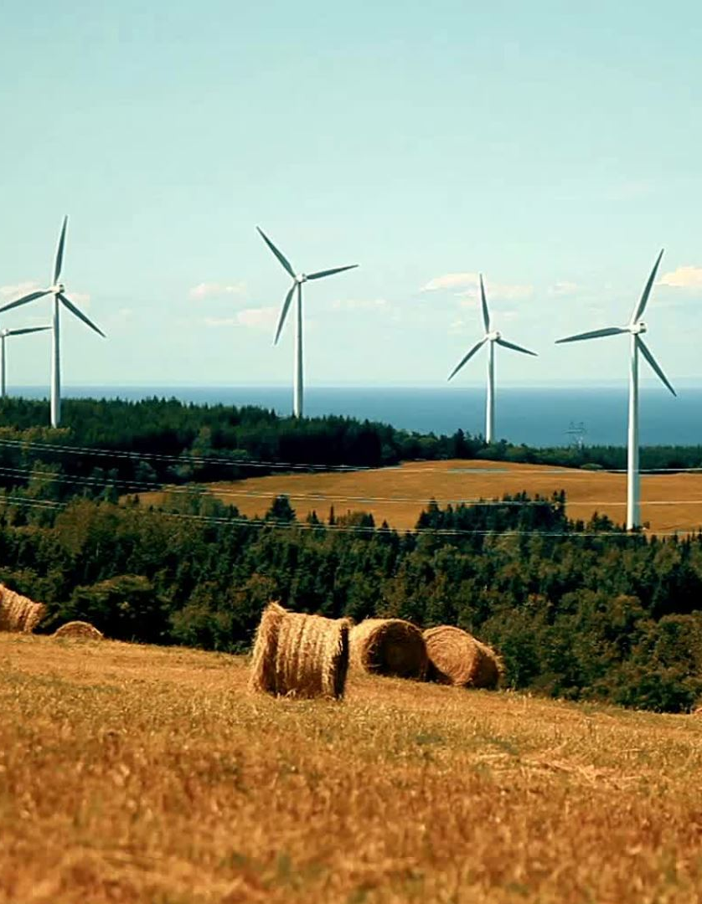
Powering the Future: Demand Insights for a Renewable Energy Revolution
Understanding current and future electricity demand trends is crucial for planning and investing in generation capacity, especially renewable sources.
As the government increases spending on renewable energy projects, knowing demand patterns helps optimize generation mix and infrastructure to meet future needs sustainably.

Slide 12
Forecasting Texas Electricity Demand: A Path to a Renewable Future
Forecasting demand using historical data from 2019 to April 2024 enables optimizing renewable energy capacity to meet future needs while reducing carbon emissions.
Our forecasting model was highly accurate, with predicted values being within 3% of actual values during testing, and an overall low error rate.
Continuous model improvement is needed to account for additional factors affecting demand trends for more accurate predictions.

Slide 13
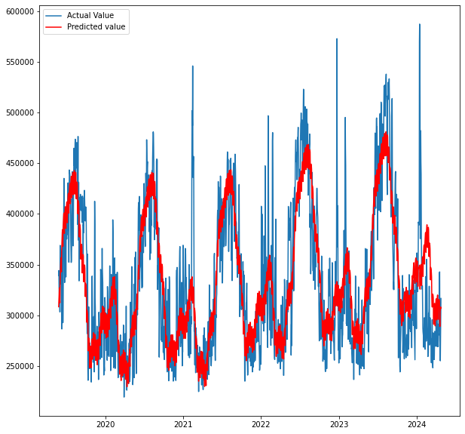
Forecasting Texas Electricity Demand: Capturing Seasonality
The Facebook Prophet model effectively captures seasonality trends in electricity demand, enabling accurate forecasting of future consumption patterns

Slide 14
Demand Forecasting: Optimizing Texas' Renewable Energy Transition
Demand forecasting enables optimizing generation mix by prioritizing renewable sources over non-renewable, reducing unutilized capacity and improving overall efficiency.
Replacing 1 MWh of non-renewable electricity with renewables saves approximately 0.6-1.0 metric tons of CO2 emissions, according to online carbon footprint calculators.
Investing in long-term transmission infrastructure is crucial to transport renewable energy from generation sites to demand centers, reducing curtailment.
Implementing demand response programs and improving energy efficiency standards can help manage peak demand and reduce the need for additional generation capacity
Notes:
Links to research paper from where we got the metric tons of CO2 emission reduction for switching from renewable to non-renewable sources:
https://www.mdpi.com/2071-1050/11/9/2502
https://www.mdpi.com/2071-1050/12/18/7402
Links for calculating CO2 emissions for generating electricity from a renewable source plant:
- https://h2iq.org/calculate-co2-your-electricity-consumption-generates/
- https://www.dallasfed.org/~/media/documents/research/swe/2019/swe1903c.pdf

Slide 15
Texas Leads the Nation in Renewable Energy Capacity?
As of 2021, Texas had an installed wind capacity of around 35,000 MW and solar capacity of around 10,300 MW, making it the national leader in wind power generation and second in solar power generation.
In weeks of summer 2023, renewable sources like wind and solar were providing 30-40% of the electricity needed to meet Texas' record-breaking energy demand during heatwaves. On some days, renewables contributed over 50% of the state's total generation.
While Texas has significant renewable capacity installed, the utilization can vary based on weather conditions and transmission constraints. There are occasional bottlenecks in distributing renewable energy across the state during peak demand hours.

Slide 16

References & Thank You
1 U.S. Energy Information Administration (EIA) analysis on Texas energy profile
Wikipedia article on Energy in Texas
2 Statista data on Texas electricity generation mix by source in 2021
3 Baker Institute article on Electricity in Texas
U.S. Department of Energy article on energy production by state
CALCULATE THE CO2 YOUR ELECTRICITY CONSUMPTION GENERATES
Yang, S.; Zhang, D.; Li, D. A Calculation Model for CO₂ Emission Reduction of Energy Internet: A Case Study of Yanqing. Sustainability 2019, 11, 2502. https://doi.org/10.3390/su11092502

